Slide 1
THE PROJECT: PENS AND PRINTERS – NEW PRODUCTS SALES ANALYSIS BY; ERICK

Slide 2
TABLE OF CONTENTS
The Business goals
How many customers were there for each approach?
What does the spread of the revenue look like overall? And for each method?
Was there any difference in revenue over time for each of the methods?
Based on the data, which method would you recommend we continue to use?
The Business Metrics
The Recommendations

Slide 3
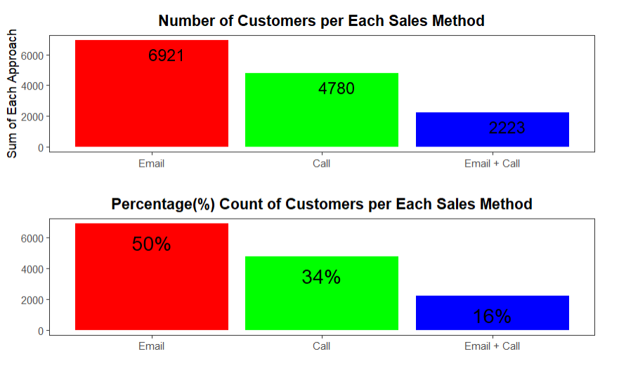
1. How many customers were there for each approach?
 | The Email sales method has the vast majority of customers: 6,921 (50%) in total. Followed by Call sales method and last the Email + Call approach with 4,780 (34%) and 2,223 (16%) customers respectively.

Slide 4
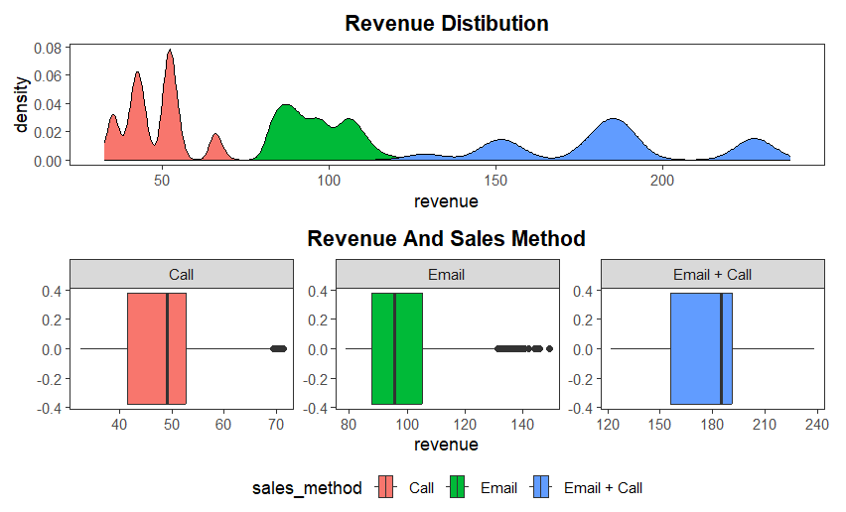
2. What does the spread of the revenue look like overall? And for each method?
 | Low revenues were majorly generated by the calls method. This can be clearly seen on the Call graph above, with revenue ranging between 0-70 Email sales_approach generated revenues in the range of 80-120, with larger values start from 130-150. Both (Email + Call) generate higher revenues ranging from 120-240 as seen from the histogram and boxplot for Email + call.

Slide 5
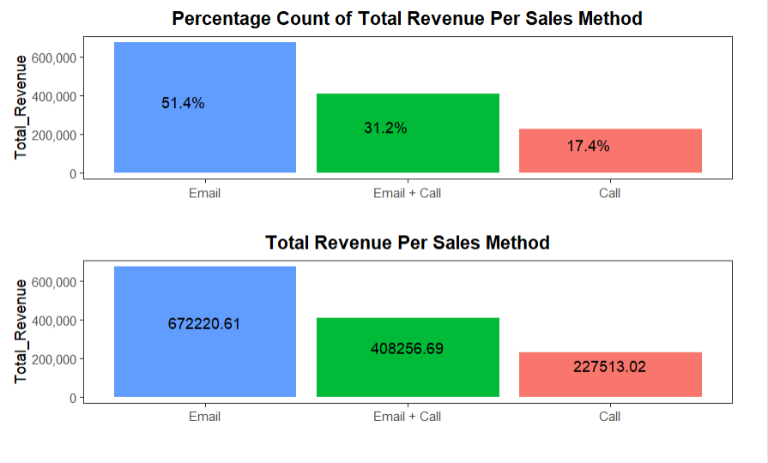
3. TOTAL REVENUE PER EACH SALES METHOD
 | It can be seen that the Call method bring less revenue in comparison to the Email and (Email + Call) method. The Call method, generated only 17.4% of the total revenue as compared to the 31.2% generated through the Email + Call approach. But the Email sales method generate the higher revenue of 51.4% of the total revenue.

Slide 6
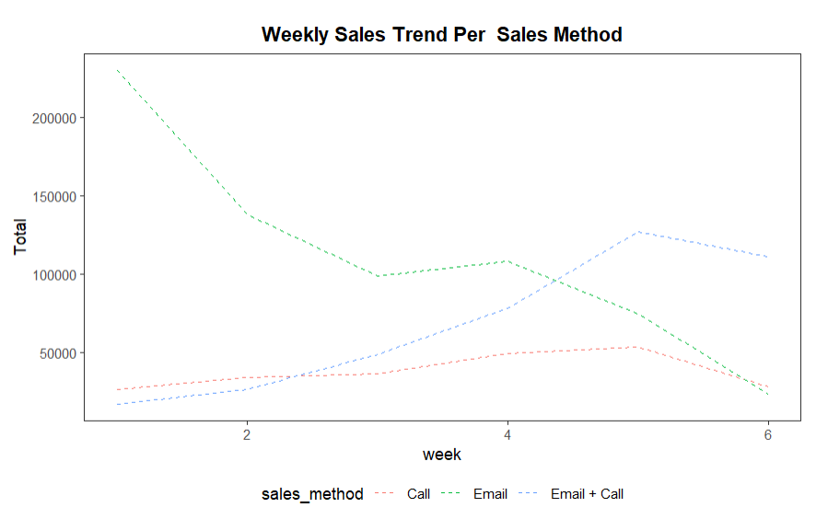
4. Was There Any Difference In Revenue Over Time For Each Of The Methods?
 | Briefly we can see that there is a positive increase in the revenue from 1st to 5th week for the Call and (Email + Call) sales methods, with a decline on week 6. While for the Email sales method we can see the negative revenue trend on a weekly basis, from week 1 to 6.

Slide 7
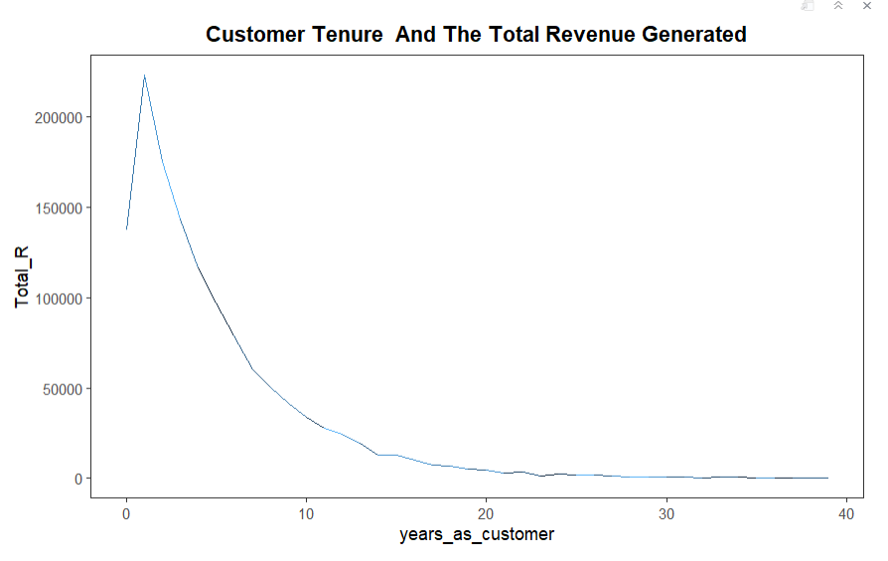
Relationship of Customer Tenure and the Total Revenue Generated?
 | The plot demonstrates the correlation between weekly revenue generated after product launch and customer tenure. The declining trend indicates that the majority of revenue comes from new customers who have been existing a period of 0 to 10 years.

Slide 8
The Business Metrics
Based on the analysis done, I do recommend discontinuing the Calls method and focusing only on Email and (Email + Call) sales method. This is due to the higher sales and revenue generated by these approaches, as well as the shorter average time required per sale compared to calls approach which is (30 minutes). However, the Calls approach can still be used on condition the customer doesn't have an email address.

Slide 9
The Recommendations
Based on the analysis conducted using the provided data, the following recommendations are proposed:
Monitor key metrics to track any changes in the sales approach.
It is recommended to utilize the Email method frequently to inform customers about new products. Additionally, follow-up calls in the second and third week can be made to discuss their needs and how the new product will assist them.
It is advisable to minimize the usage of the Call method or eliminate it altogether. This approach consumes more time for sales and ultimately generates the lowest revenue, despite having a higher number of sales.

Slide 10
The sales team should prioritize the Email and Email + Call approaches. As demonstrated in analysis, the Email sales approach yields the highest revenue during the initial three weeks, although it declines as the week progresses. To enhance sales and generate more revenue, a follow-up call should be made in the second or third week.
To broaden the customer segment, focus on enhancing marketing strategies and improving the conversion rate based on website visits. As indicated in the correlation graph, the longer customer tenure corresponds to lower revenue. To address this, onboard new customers and establish customer retention initiatives to boost sales and revenue from both new and existing customers.
Ensure accurate data collection to facilitate comprehensive analysis, particularly for revenue, which contains numerous missing values.

